Slide 1
Windshield survey
Mexico community

Slide 2
Introduction
Mexico is a country of southern North America.
Is the third largest country of Latin America.
Mexico has an array of interesting features
It is among the most fascinating areas to explore in the world

Slide 3
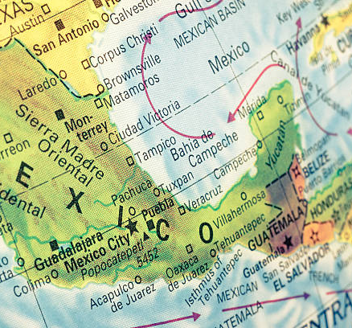
Map of Mexico
The above shows the Map of Mexico depicting it geographical location and features

Slide 4
Subjective feelings
Welcoming people.
The people of Mexico have a general culture of welcoming people.
Unique cuisines, music , architecture
Unique History which depicts the unique features of Mexico
Diverse culture and good terrain which supports people form different backgrounds.

Slide 5
Community needs
Curbing air pollution menace.
The air quality needs to be improved
Fix the sources of pollution by;
by introductions of cleaner forms of energy.
Civic education on environmental conservation
Educational Campaigns.

Slide 6
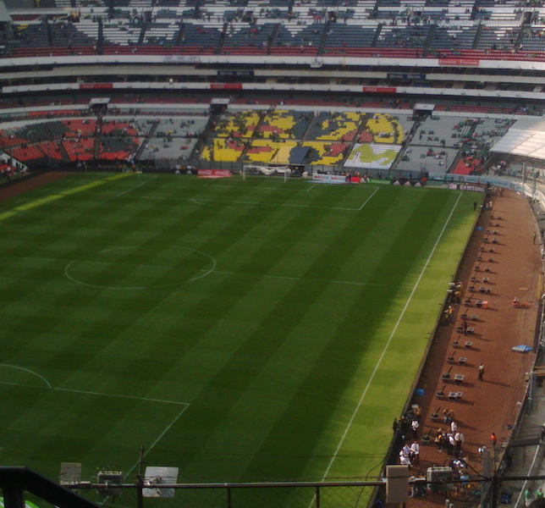
Football field in Mexico:Estadio Azteca pitch
Among the community assets of Mexico is the foot ball field and other wide range of infrastructure.

Slide 7
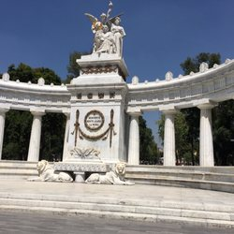
Photo of Alameda park
The park is also among the community assets of Mexico

Slide 8
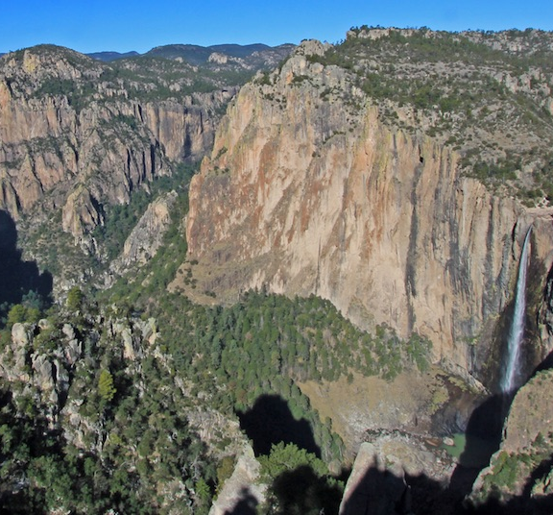
Basasea chick Falls park
This is also among the community assets of Mexico displaying the beautiful scene

Slide 9
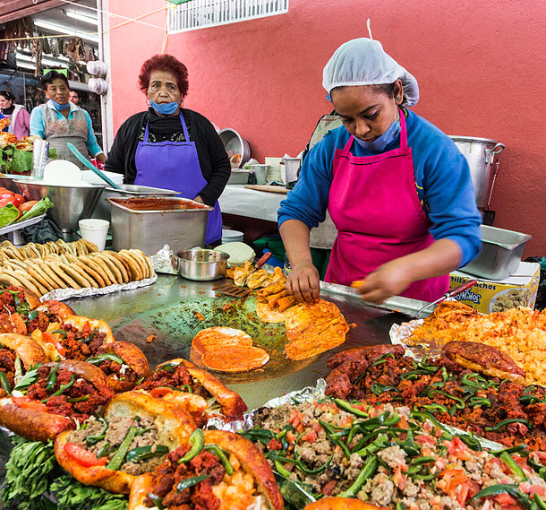
A local restaurant in Mexico.
The restaurant displays the cultural diversity of Mexico where food is prepared differently.

Slide 10
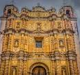
Church in Mexico
The church represents the religious faith of different people in Mexico

Slide 11

A school in Mexico
The school hosts a large proportion of students and re[present the education structure in Mexico

Slide 12
Conclusion
Mexico is one of the best cities in the world.
With well developed infrastructure.
And a rich culture.

